Slide 1
Chess Engine
Leonardo Santangelo - 3052450

Slide 2
Content
Introduction to chess engines
Representing the board
Finding legal moves
Evaluation functions
Minimax
Alpha-Beta pruning
Advanced optimization techniques

Slide 3
What exactly is a Chess Engine
A Chess Engine, in essence, is a piece of software that can play the game of Chess.
There are a series of tasks that we intuitively expect any chess engine to be able to do. In particular:
  Internally represent the board, the pieces and the rules of the game;
  Generate all the possible legal moves from any given position;
  Determine which player has the advantage in any given position and by how much;
  Efficiently search the tree of possible states of the game to find the best move from any given position;

Slide 4
Representing the board
The first choice we must make in the development of any chess engine is how we are going to represent the internals of the game.
We can identify two main approaches to this problem:
  A piece-centric approach, where each piece (type) is directly associated to the position(s) it occupies on the board (usually by means of a binary mask, also called bitboard in this context).
  A square-centric approach, where each square is directly associated to the piece standing on it (generally called mailbox addressing as to indicate that each piece has its own address, so to speak).
For this engine we decided to opt for a piece-centric approach using bitboards, as it is generally more performant and memory-efficient.

Slide 5
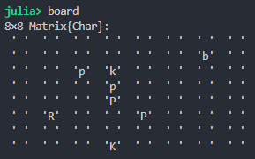
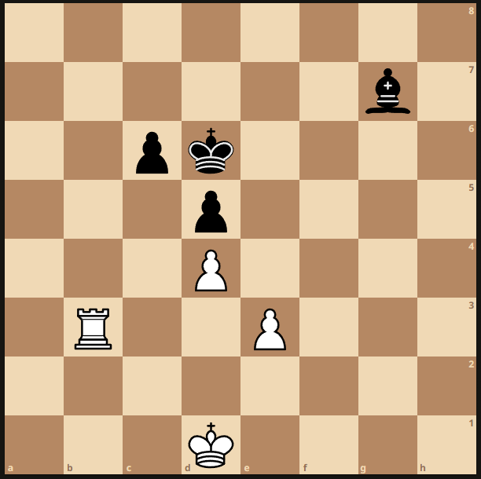
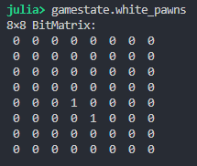
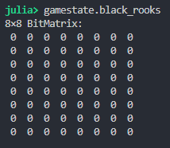
Example: Piece-Centric vs Square-Centric Representation
Square-Centric
The focus is on what resides on each square. We store a single array with encodings of the pieces each in its own address (square). Generally easier to implement but less performant.
Piece-Centric
The focus is on where each piece resides on the board. Each piece-color combination has its own bitmask, which can be used to submit queries to the game state. More involved to implement but also more performant.

Slide 6
Bitboards as integers
Since ultimately a bitboard is the representation of an 8x8 binary mask encoding some property of the game state. It becomes intuitive to store it as an unsigned 64-bit integer instead of an array.
In addition to encoding the positions of the pieces on the board, we can use bitboards to represent a variety of properties of the game state. For example, a bitboard representing the squares attacked by a player makes it easy to compute the legal moves for the opposing player’s king.
In our engine, as it has become standard practice in all modern engines, many useful bitboards are precomputed even before the game begins (e.g., the possible knight landing squares from each starting square on the board, or the masks for the single files and ranks of the board).

Slide 7
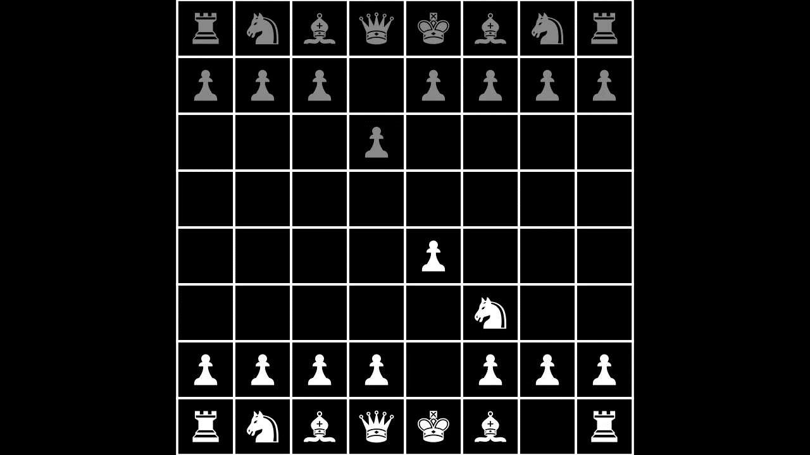

Slide 8
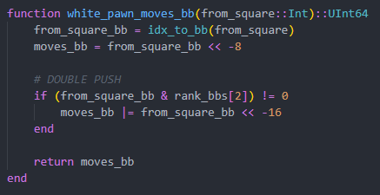
Computing bitboards via Bit-Shifting
Given our current representation, it becomes easy and fast to generate new bitboards using nothing other than binary shifts.
The representation we chose to use is rank-wise big endian (matrix-like), which corresponds to the following shifts:
In the function to generate the white pawn
moves, we turn the current position of the
pawn into a bitboard and shift it by -8, which
corresponds to a movement upwards. Additionally, we also check if a double push is possible, and in that case also OR a shift of -16.
-9 | -8 | -7
-1 | +0 | +1
+7 | +8 | +9

Slide 9
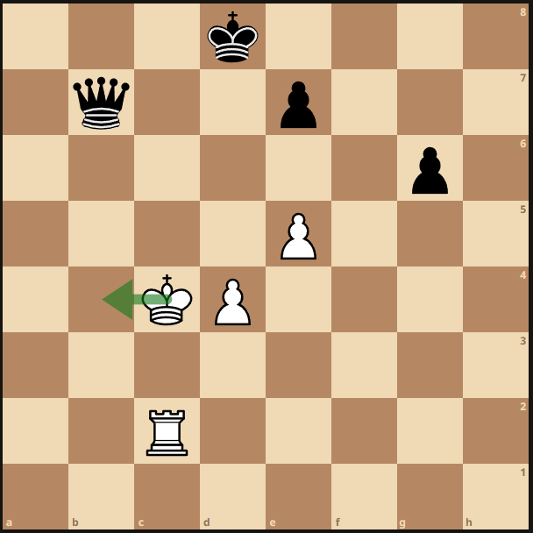
Pseudo-legal vs Legal moves
In Chess, a pseudo-legal move is a move that adheres to the rules dictating how the pieces move. For example, moving a pawn horizontally is not a pseudo-legal move. In other words, in determining if a move is pseudo-legal or not, we do not care about the resulting position on the board after the move.
On the contrary, for a move to be considered legal, in addition to being pseudo-legal, it must be the case that the position following the move is legal, i.e., no side can capture the opposing side’s king.
Generating pseudo-legal moves is generally an easy task, however, to determine if a given pseudo-legal move is also legal (i.e., if the engine should consider it in the search), we must proceed with care.
This move is pseudo-legal but not legal

Slide 10
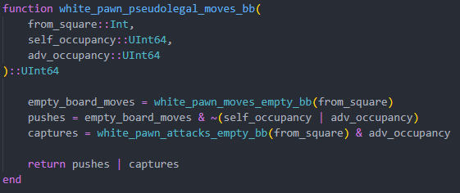
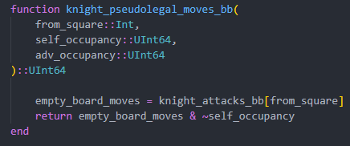
Generating pseudo-legal moves
The general procedure for generating pseudo-legal moves is the following:
  Compute the pseudo-legal moves for the piece on an empty board via bit-shifting
  Intersect the resulting bitboard with the inverse of the bitboard corresponding to the squares the squares where the piece cannot go.

Slide 11
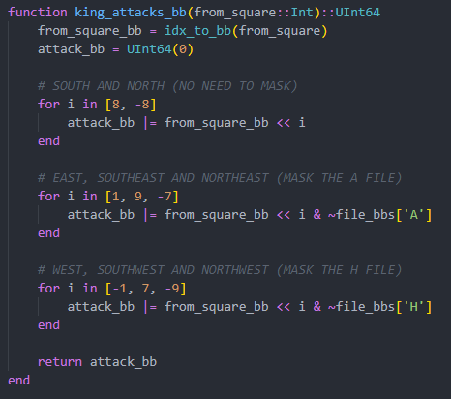
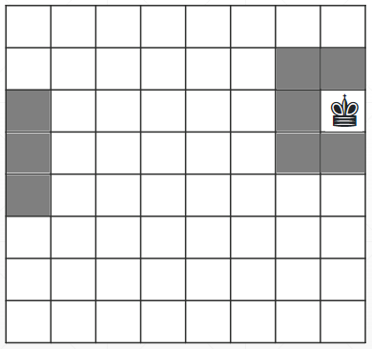
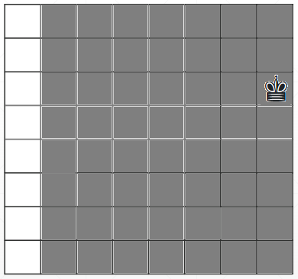
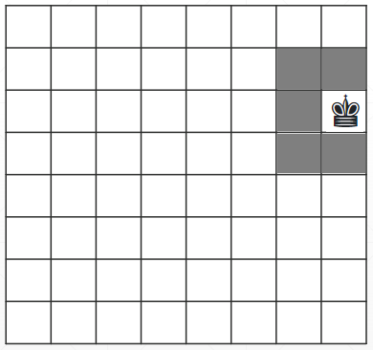
Example: King moves on an empty board
&
=

Slide 12
Generating pseudo-legal moves for sliding pieces
In Chess, the rook, the bishop and the queen are called sliding pieces.
They move by sliding on the board and cannot go over other pieces like the knight does.
Computing the pseudo-legal moves for these pieces is a bit trickier but there exists a very elegant algorithm we can employ.
Given a bitboard for the blockers of the sliding motion of the piece:
  Intersect the bitboard of the sliding ray (precomputed) with the blockers bitboard;
  Find the index of the set bit closer to the moving piece in the resulting bitboard;
  Intersect the sliding ray from the piece with the inverse of the sliding ray from the blocker;

Slide 13
Example: Rook moves in the upwards direction
 |  |  | ♞
 |  |  | ♟
 |  |  | ♖
 |  |  | ♞
 |  |  | ♟
 |  |  | ♖
&
Sliding ray from piece
Blockers

Slide 14
Example: Rook moves in the upwards direction
 |  |  | ♞
 |  |  | ♟
 |  |  | ♖
 |  |  | ♞
 |  |  | ♟
 |  |  | ♖
Closest set bit
to the rook
&
Sliding ray from piece
NOT (Sliding ray from nearest blocker)

Slide 15
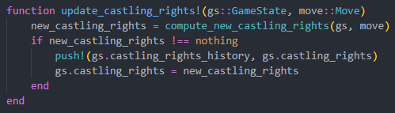
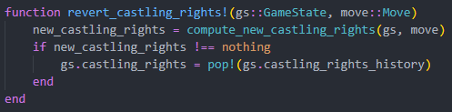
«Special» moves: Castling, Enpassant
In addition to the standard moves, in some positions, players have special moves at their disposal. The rules governing these special moves are fairly complex, requiring us to be careful with our implementation.
The legality of castling and enpassant moves cannot be absolutely determined by only looking at the disposition of the pieces on the board.
In order to be able to apply and undo moves (necessary to search the game tree), we use a stack of castling rights structs. Whenever we detect a move that can affect the castling rights (e.g. the king moves), we push a new struct on the stack, and when it comes time to undo the move, we pop from the stack.

Slide 16
Filtering out illegal moves
Now that we have a list of pseudo-legal moves, we need to filter out those that result in an illegal position.
We could in theory just apply them, check if the moving player can capture the king and undo them. However, this effectively forces the engine to generate many vectors of pseudolegal moves unnecessarily, which leads to a significant overhead considering the millions of positions we will need to evaluate.

Slide 17
Filtering out illegal moves
The first step in filtering illegal moves is to compute all the squares attacked by the opposing player, we just need to do it once.
There are three cases in which a move leads to an illegal position:
  The king moves to a square attacked by an enemy piece
  An absolutely pinned piece moves, leaving the king exposed
  An enpassant capture clears a line of attack from a sliding piece to the king (rare)
If the king is in check, we also have the option to capture the checking piece (or blocking the check) with one of our own, so we will have to take that into account.

Slide 18
Evaluation functions
In order to be able to choose among the available moves, our engine needs to know how to evaluate a position.
An evaluation function for a 0-sum game like Chess, takes a game state as input and outputs a real number between minus and plus infinity.
The output of the evaluation function corresponds to the advantage the white player has in the position.
Naturally, the black player will try to minimize the function, while the white player will try to maximize it.

Slide 19
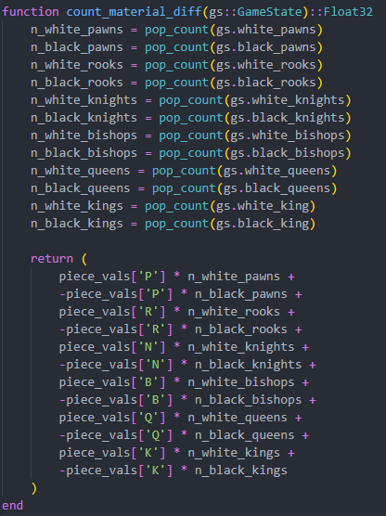
Evaluation functions
The simplest evaluation function could be to just assign a value to each piece type and count the pieces on the board.
While this is intuitive and fast to compute, it completely
forgoes any consideration on the strategic placement of
the pieces.
For this reason, we add a term to the crude material
difference.

Slide 20
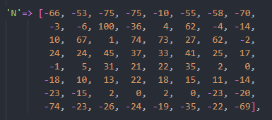
Evaluation Functions
To account for the strategic placement of the pieces, we can create piece-specific «heatmaps».
The strategic gain of a given move comes from the value in the heatmap of the moved piece minus the value in the heatmap of the captured piece (which is reversed and negated for the black pieces).
For example, knights should avoid the borders
and play around the center.
The heatmaps we choose influence the engine’s
behaviour, so we can use them to tweak the
engine’s playstyle.

Slide 21
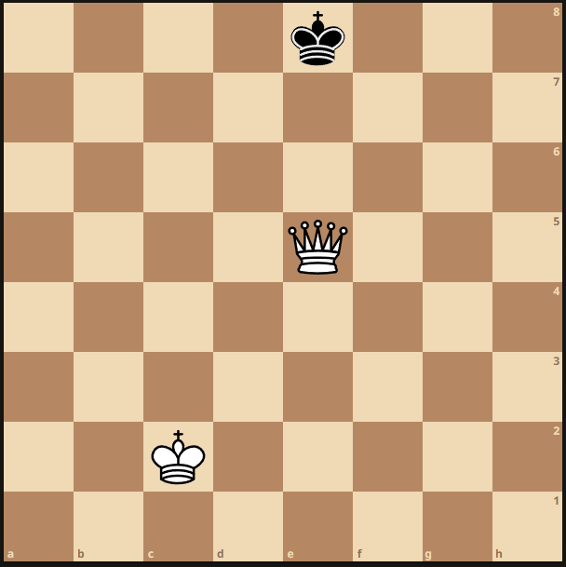
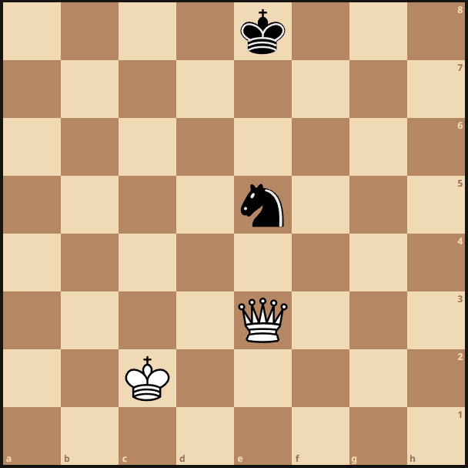
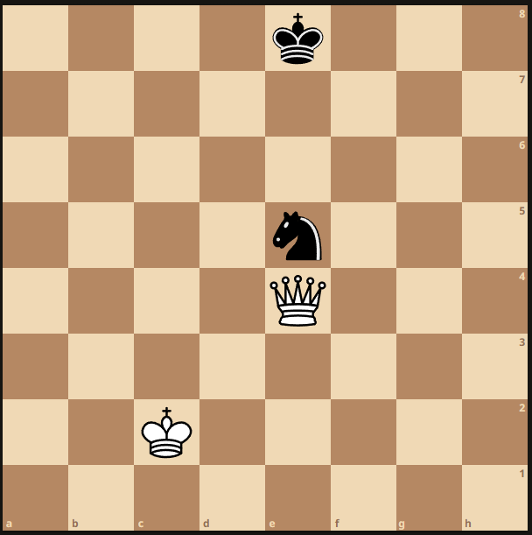
Example: Game Tree of depth 1
…
Evaluation: 9
Qe5+
Qe4
Evaluation: 6
…

Slide 22
Example: Game Tree of depth 1
…
Evaluation: 9
Qe5+
Qe4
Evaluation: 6
…

Slide 23
Minimax
In a game like Chess, in any given position there are several possible moves (in our case, around 35), each of which leads to a new «child» position, which will have its own «children» positions and so on, in a tree-like fashion.
We can build a game tree of a certain depth d from a root position by iterating through all the possible child positions of the root and building a tree of depth d-1 from there, recursively until we reach d = 0.
Since at each level of the tree the moving player alternates, this is a case of a sequential 0-sum game with perfect information.
In this type of games, we can use an algorithm called minimax to navigate a deep game tree and determine the best move from the root position.

Slide 24
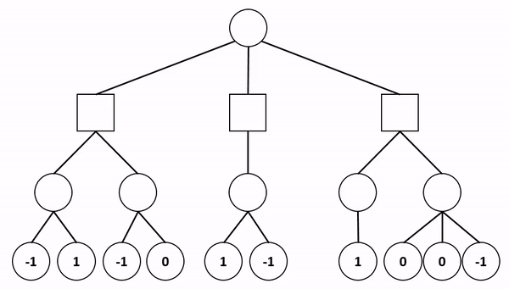
Minimax visualized
In this example, Circle is the maximizer, while Square is the minimizer

Slide 25
Minimax
Minimax relies on the fact that we can determine the best opponent’s move in any given position.
In a position p at depth d-1, if our minimizing (maximizing) opponent is faced with a choice of moves, he is going to pick the move that leads to the child position with the lowest (highest) evaluation.
Knowing this, we assign to p the value of the child position following the opponent’s chosen move. We will naturally want to perform the opposite operation, so at d-2 we will pick the move that leads to the node at depth d-1 with the highest (lowest) evaluation.
This procedure goes on recursively, alternating minimization and maximization, until we reach the root node.

Slide 26
Alpha-Beta pruning
While the naive minimax exploration works for small game trees such as the one for Tic-Tac-Toe, in a game like Chess, the size of the tree grows too quickly for us to perform any kind of useful exploration in an appropriate time.
Luckily for us, since we are analyzing branches sequentially, there is a trick we can employ to speed up the search.
At any given depth d, while we compute the value of a node p, we are aware of the values of the other nodes at depth d that originated from branches we have already looked at.
This means that, as soon as we determine that the value of p could never be lower (higher) than the minimum (maximum) of its siblings, we can stop computing it (i.e., we prune that particular branch).

Slide 27
Alpha-Beta pruning visualized
$$α =−∞ ; β=+∞$$
𝛼 =−∞ ; 𝛽=+∞
$$α=−∞ ;β= +∞$$
𝛼=−∞ ;𝛽= +∞
-1

Slide 28
Alpha-Beta pruning visualized
$$α =−∞ ; β=+∞$$
𝛼 =−∞ ; 𝛽=+∞
$$α=−1 ;β= +∞$$
𝛼=−1 ;𝛽= +∞
3
-1

Slide 29
Alpha-Beta pruning visualized
$$α =−∞ ; β=+∞$$
𝛼 =−∞ ; 𝛽=+∞
3
$$α=3 ;β= +∞$$
𝛼=3 ;𝛽= +∞
3
-1

Slide 30
Alpha-Beta pruning visualized
$$α =−∞ ; β=3$$
𝛼 =−∞ ; 𝛽=3
3
$$α=3 ;β= +∞$$
𝛼=3 ;𝛽= +∞
3
$$α=−∞ ;β=3$$
𝛼=−∞ ;𝛽=3
-1
We are aware of the values
of the other branches

Slide 31
Alpha-Beta pruning visualized
$$α =−∞ ; β=3$$
𝛼 =−∞ ; 𝛽=3
3
$$α=3 ;β= +∞$$
𝛼=3 ;𝛽= +∞
3
$$α=5 ;β=3$$
𝛼=5 ;𝛽=3
5
-1

Slide 32
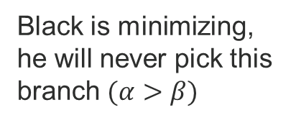
Alpha-Beta pruning visualized
$$α =−∞ ; β=3$$
𝛼 =−∞ ; 𝛽=3
3
$$α=3 ;β= +∞$$
𝛼=3 ;𝛽= +∞
3
≥5
$$α=5 ;β=3$$
𝛼=5 ;𝛽=3
5
-1
Black is minimizing, he will never pick this branch $(α>β)$

Slide 33
Alpha-Beta pruning visualized
3
$$α =−∞ ; β=3$$
𝛼 =−∞ ; 𝛽=3
3
$$α=3 ;β= +∞$$
𝛼=3 ;𝛽= +∞
3
≥5
$$α=5 ;β=3$$
𝛼=5 ;𝛽=3
5
-1

Slide 34
Alpha-Beta pruning
Note: alpha and beta represent the best achievable scores (in that branch) for the maximizing and minimizing player, respectively.
If we find that the best score in a given branch is less (more) than the best achievable across some other previously seen branch, there is no reason to keep looking at that branch any longer.
This implies that the order in which we iterate the branches is paramount to prune as much of the tree as possible, as we want to compute the values for the moves that are likely to be superior first.

Slide 35
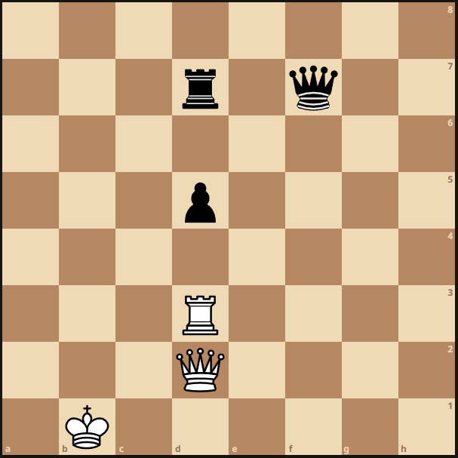
Quiescence Search
Imagine we are searching a game tree of depth 3 every time we want to make a move and consider the following position:

Slide 36
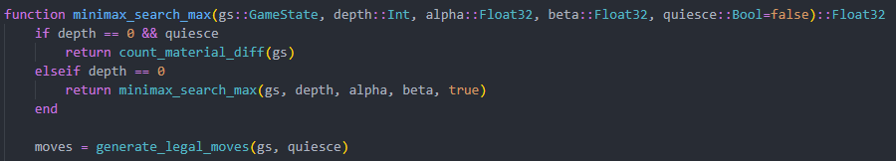
Quiescence Search
With a depth of only 3, we would not be able to see that capturing the pawn is a bad move, so we would happily capture it with the rook.
In order to avoid these kinds of blunders, at the end of the tree we keep searching only among the capture moves from the leaf positions.
This kind of search is commonly called quiescence search.

Slide 37
Iterative deepening
Iterative deepening is a search technique that consists in building increasingly deeper trees from the same root position.
Keeping track of the best moves in shallower trees and using them to start the search in the construction of the deeper one can help prune large portions of the tree, as it is unlikely that a good move in a tree with a certain depth becomes unplayable when the depth increases slightly.
Iterative deepening can also be useful whenever we need our engine to operate within time constraints. If we deem that our search is taking too much time, we can interrupt it at a shallower depth.

Slide 38
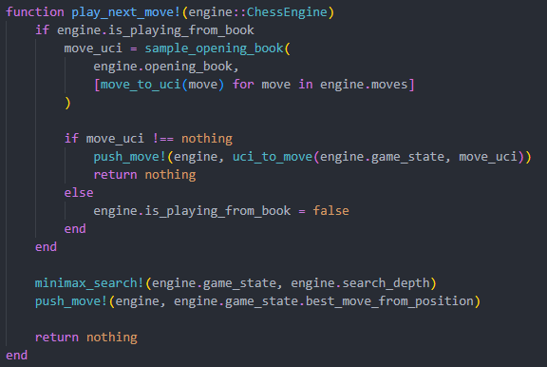
Opening book
In most modern engines, an opening book is provided to obviate the high difficulty of strategically placing the pieces in the early stages of the game.
The engine will follow a random opening from the book until the opponent plays a move that deviates from it, at which point the engine will switch to searching via alpha-beta pruning.

Slide 39
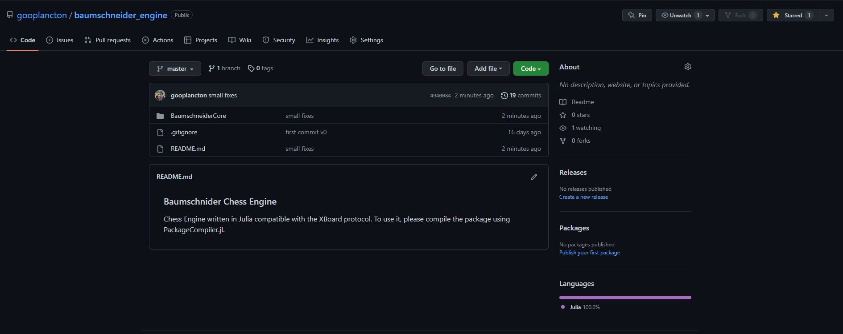

Thank you for your attention!
Star the project on GH!

